Slide 1

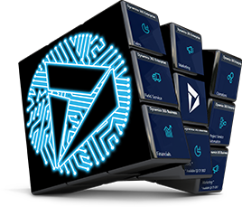



Slide 3
Agenda
Time | Room 1 | Room 2
09:00 – 10:00 | Keynote – Matthew Mead
10:10 – 11:10 | Empower! Improving business processes with the Power Platform – Victor Dantas | Getting started with PowerApps Component Framework (PCF) – Alex Shlega
11:15 – 12:15 | Enterprise CRM Implementation – An Analyst’s perspective – Lyndsay Kowalick | Get started with Dynamics 365 Virtual Agent for Customer Service – Dhina Gajavarathan
12:15 – 1:00 | Lunch Break
1:00 – 2:00 | Setting up Continuous Integration (CI) and Continuous Delivery (CD) for PowerApps/D365 CE – Alex Shlega | Dynamics 365 Data Migration Demystified – Kunal Tripathy
2:10 – 3:10 | PowerApps Lab – 365 Saturday Team | Getting the Most Out of the Field Service Mobile App – Andrew Gingerich
3:15 – 4:00 | Close & Swag

Slide 4


Enterprise CRM Implementation – An Analyst’s perspective

Slide 5
Agenda
Team Introduction
Who’s who
Our Company
Frequency Foundry
Defining the Objective
Starting a Project
Requirements
Collection & Management
Quality Assurance & UAT
How to ease the fear
Common Challenges
The things we’ve learned
Notes:
Charles

Slide 6

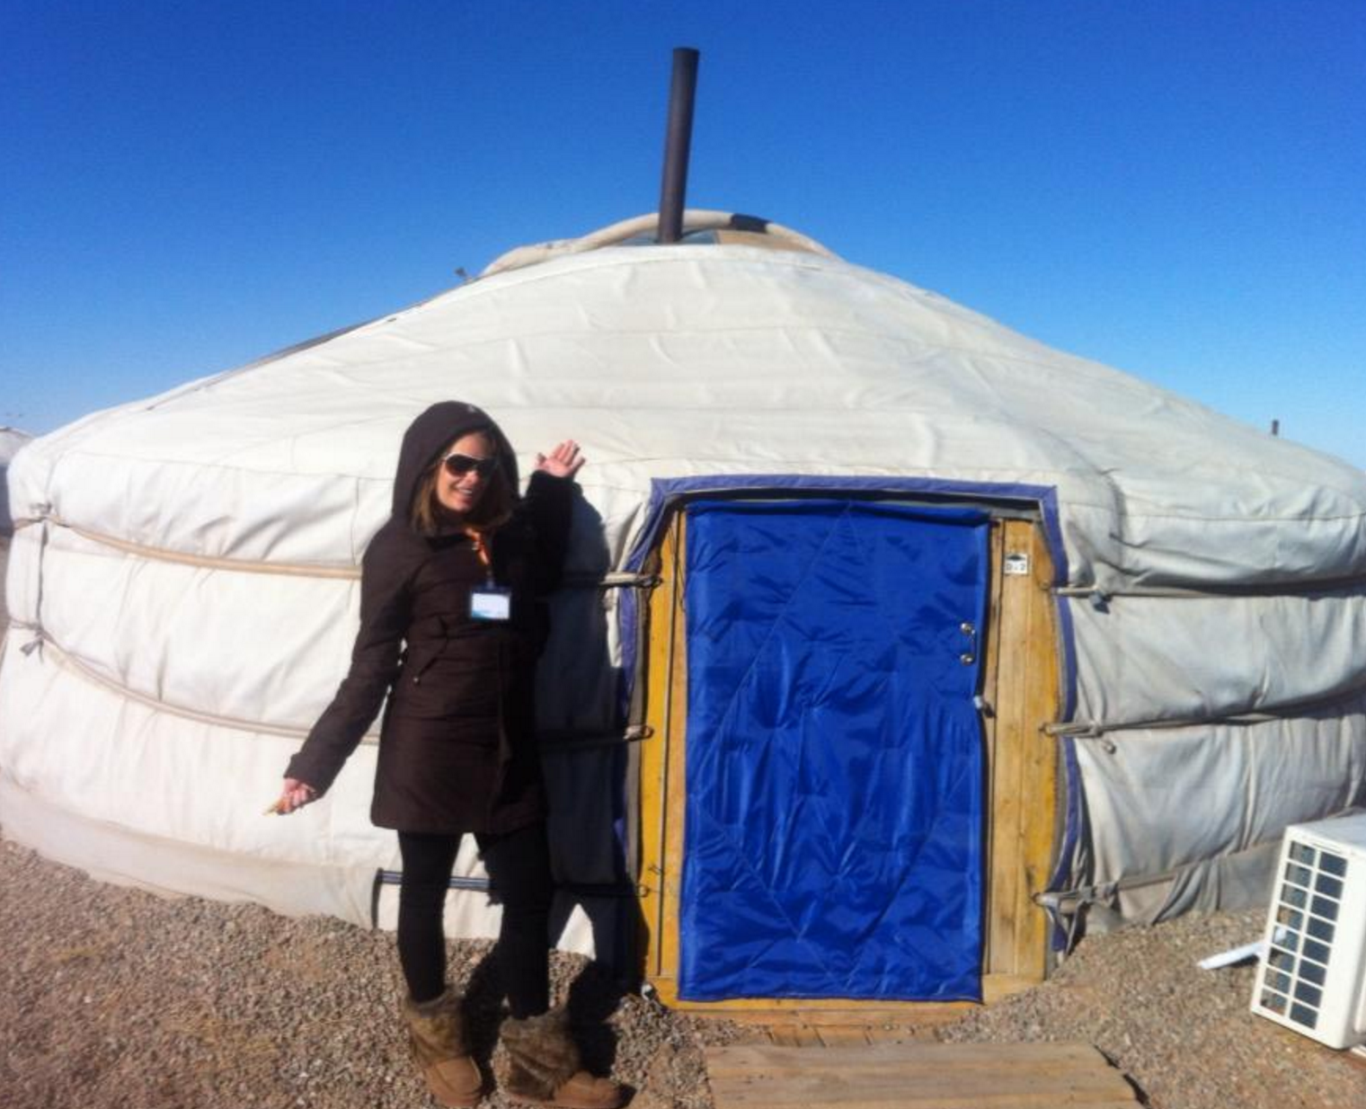
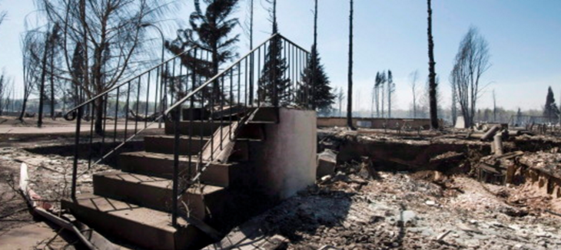


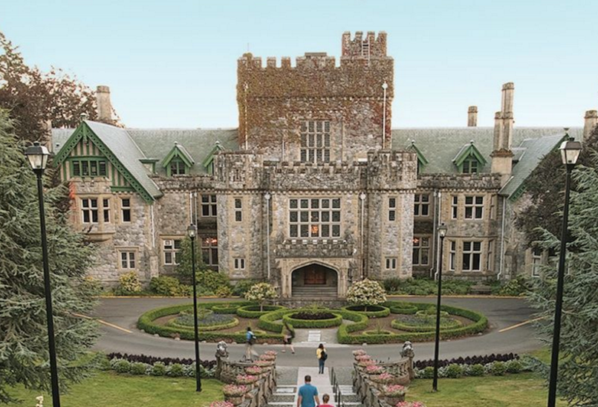
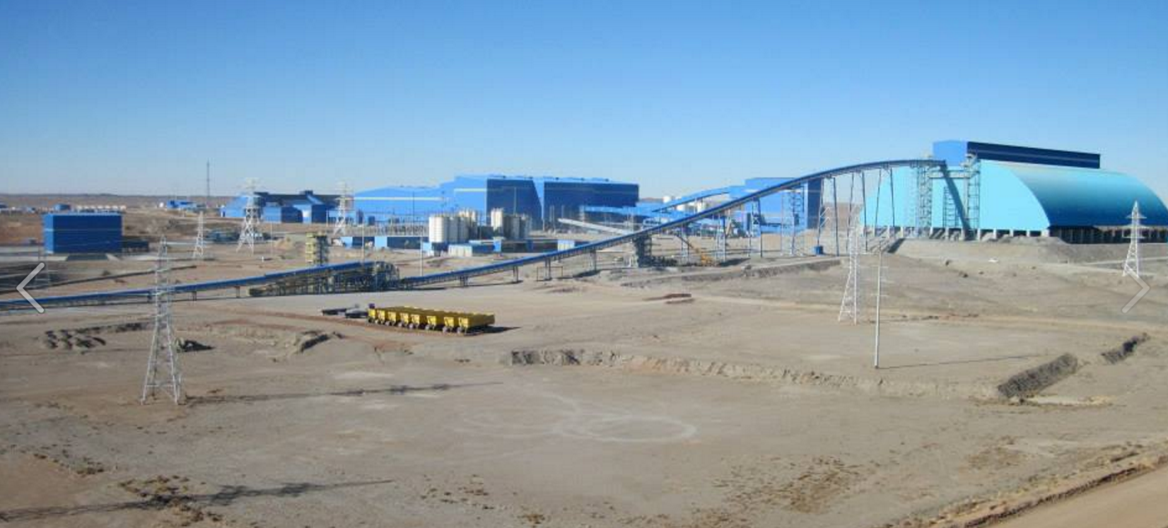
About Us
Lyndsay Kowalick
Director – Delivery Management
Notes:
Charles

Slide 7
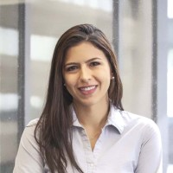


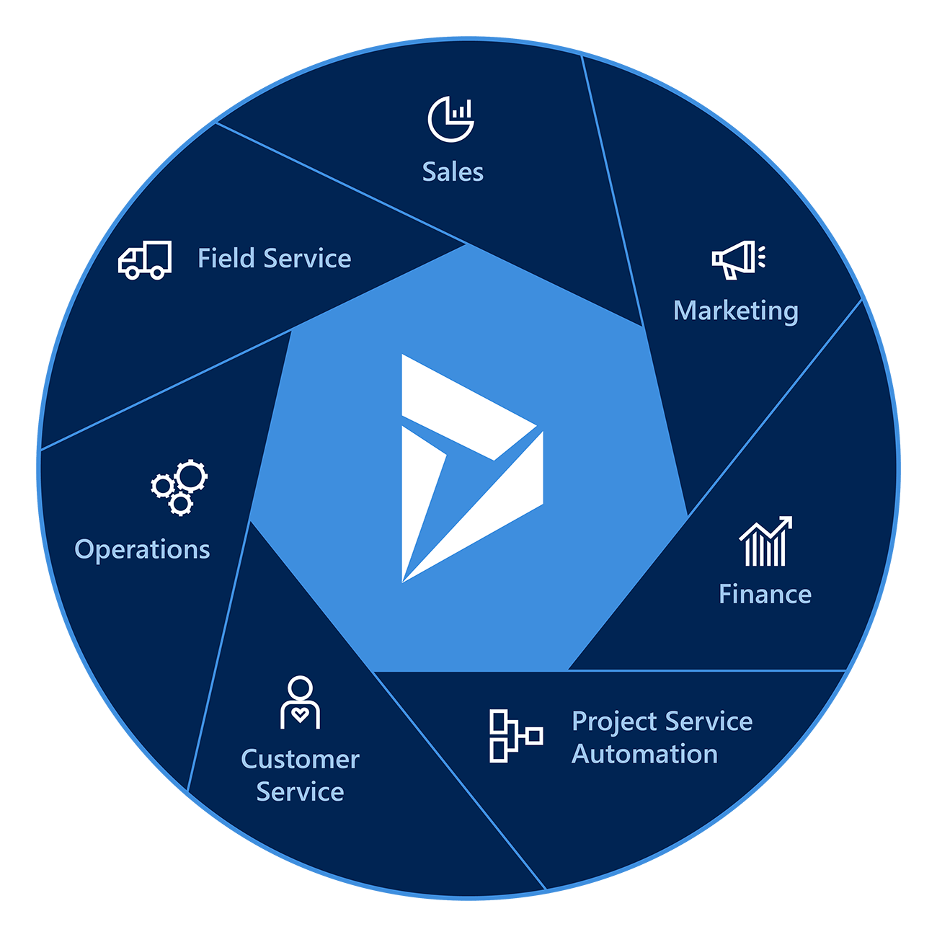

About Us
Larissa Mandello
Functional Analyst
Notes:
Charles

Slide 8
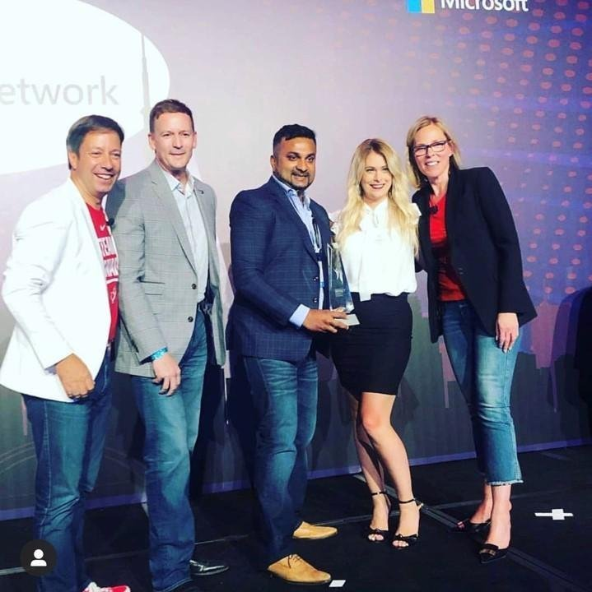
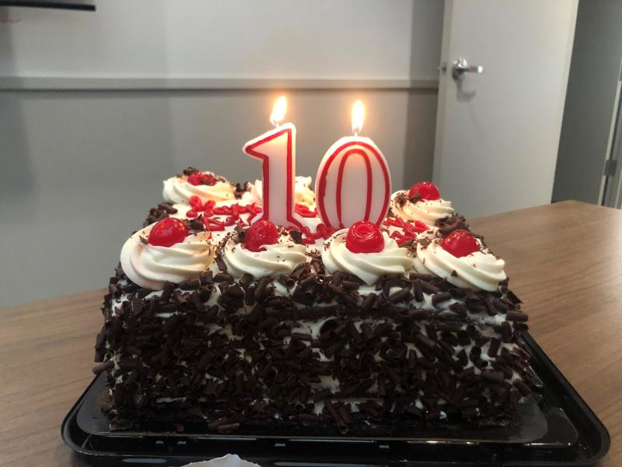
Notes:
Charles

Slide 9
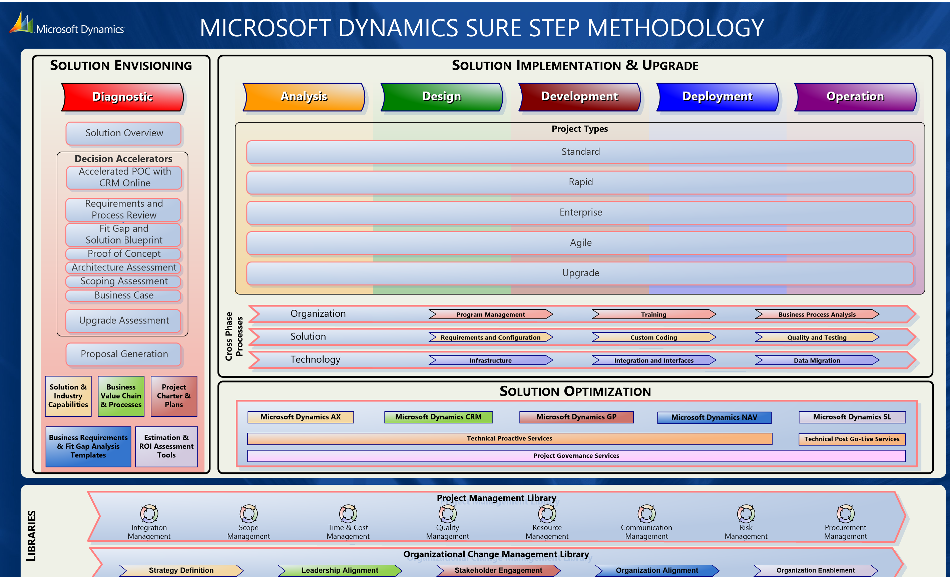
Notes:
Explain how Foundry uses a blended approach

Slide 10
What Problem Are We Trying To Solve
What led the organization to believing CRM is the answer?
What do you already know?
What are their pain points?
Who are the planned end user groups?
What does a day in the life look like for each group?
Current state: what systems are being used now?
IT STARTS WITH THE SALES TEAM

Slide 11


Who’s Involved?
Evaluating attitudes
Enterprise readiness
Overall feeling toward this project
Potential stakeholder conflicts
Sponsors
SME’s
IT
Others?
Notes:
Everyone has their own unique approach to starting a project, but the steps we complete are likely similar. An experience BA will be able to suss out the details they require to make informed decisions around the work to be done, when, and the outputs that will result from it.

Slide 12
Collecting & Managing Requirements
Requirements that come from the RFP: Validation is key!
What it involves
Ownership
What process they fit into
Why it's important?
Creating alignment
Identifying unknown stakeholders

Slide 13
Collecting & Managing Requirements
Eliciting Requirements: Surveys, Interviews, Workshops
Speak their language
What will you do with the information you collect?

Slide 14
Collecting & Managing Requirements
Current State Analysis
Process Maps
Requirements Sessions
Needs Document
Validation
Mockups
Architecture
Integration Points
Systems
Data Migration Strategy
ERD
FDD
Devops / Jira
User Stories

Slide 15
Transparency Is Key
Alignment
Approach
Language
Objective
Milestones
What are they?
Dates and tasks
Prototyping
What does this mean?
When will it happen?
What will you show?

Slide 16
Quality Assurance
Functional Testing & Variance Report
Internal testing: Mockups are the key
1st round regression testing
Defect Fixes
Defect Fixes
2nd round regression testing

Slide 17
User Acceptance Testing
Prototype Solution & Training should occur first
Often confused with QA on the project plan
Provide;
Variance report (if there is one from the mockups)
Test scripts (if in scope)
User log (Avoid 1000’s of emails)
What will you do with the log received?
Sign-off (Make it formal!)
Defect Fixes
1st round regression testing
2nd round regression testing
Defect Fixes

Slide 18
Common Challenges
Template your organization’s approach
Include the client IT group early
What happens when a client misses their deadlines?
Agree to Terminology
Data Migration
Start early, obtain sources, try & try again
Formal Signoff
Project Closeouts
Notes:
1. get's uneasy. They know this is going to fall into their lap spend time at the beginning introducing them to Solutions, components, entities etc
2. OH MY GOD DATA MIGRATION; Who'd been a part of this? And did you have a Ba?
And how smooth did it go?
Data migration should NEVER be underestimated. START EARLY.
Get sample data from the sources

Slide 19

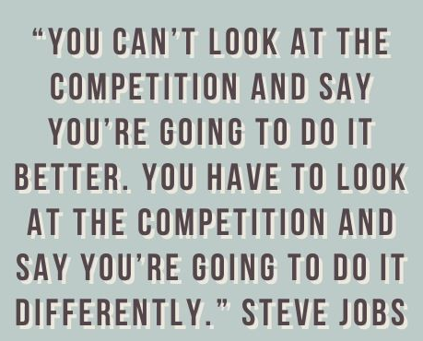
Questions
Lyndsay@frequencyfoundry.com
Larissa@frequencyfoundry.com

Slide 20
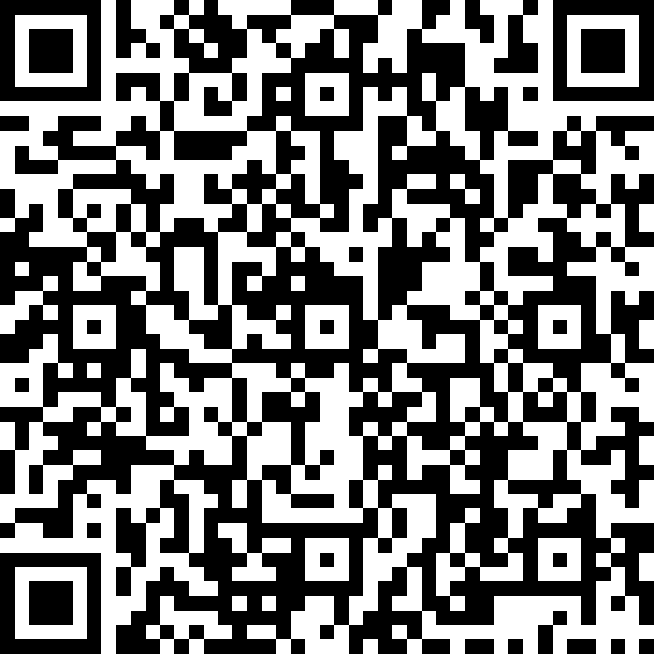
Overall Event Feedback

